Slide 1
Cognitive: Visual Recognition Gary Wilson Technical Leader & CTO, UKI Commercial Business

Slide 2
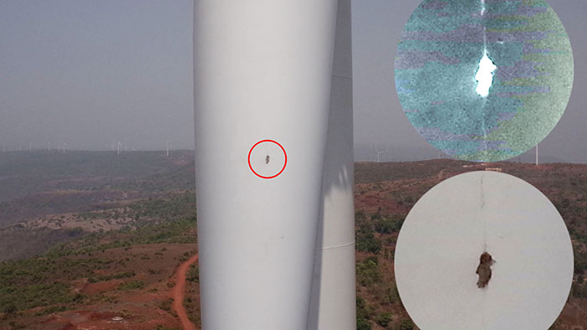
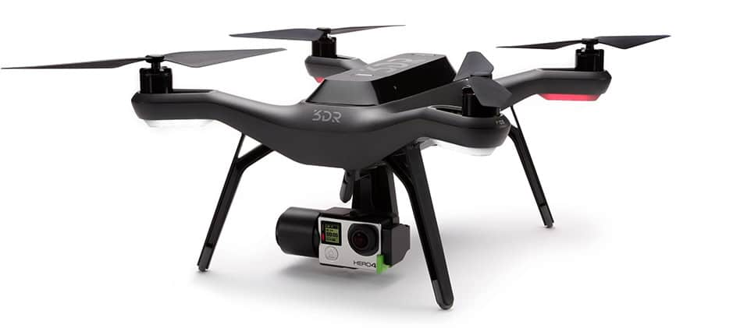
Objective
Build a simulated drone inspection application that looks for cracks in buildings / infrastructure
Watson Visual Recognition
IBM Cloud Object Storage
Node-RED
dashboard UI, mapping

Slide 3
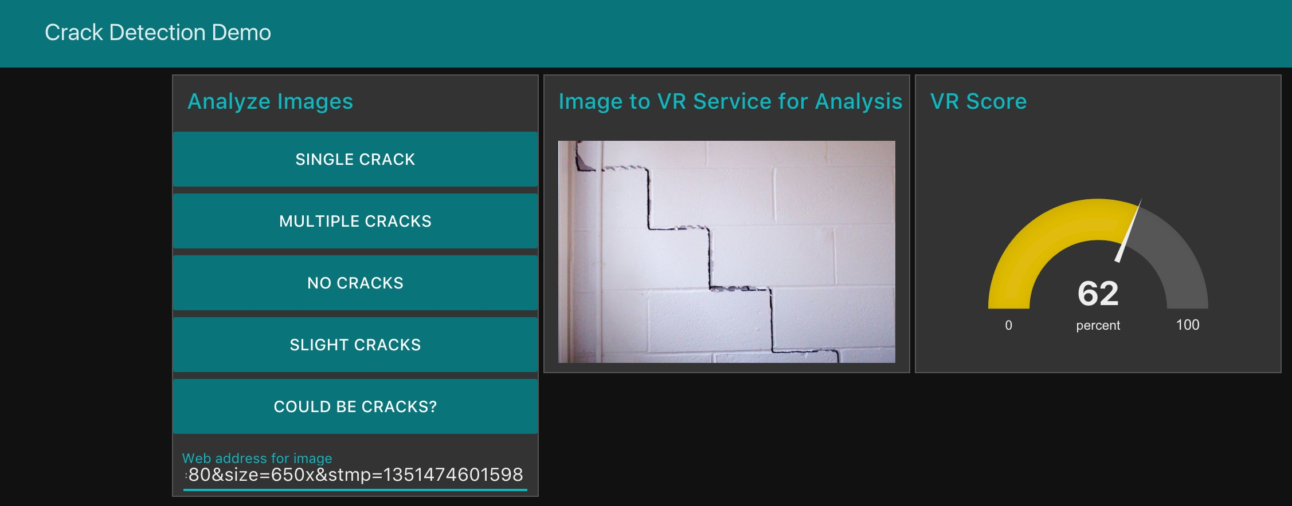
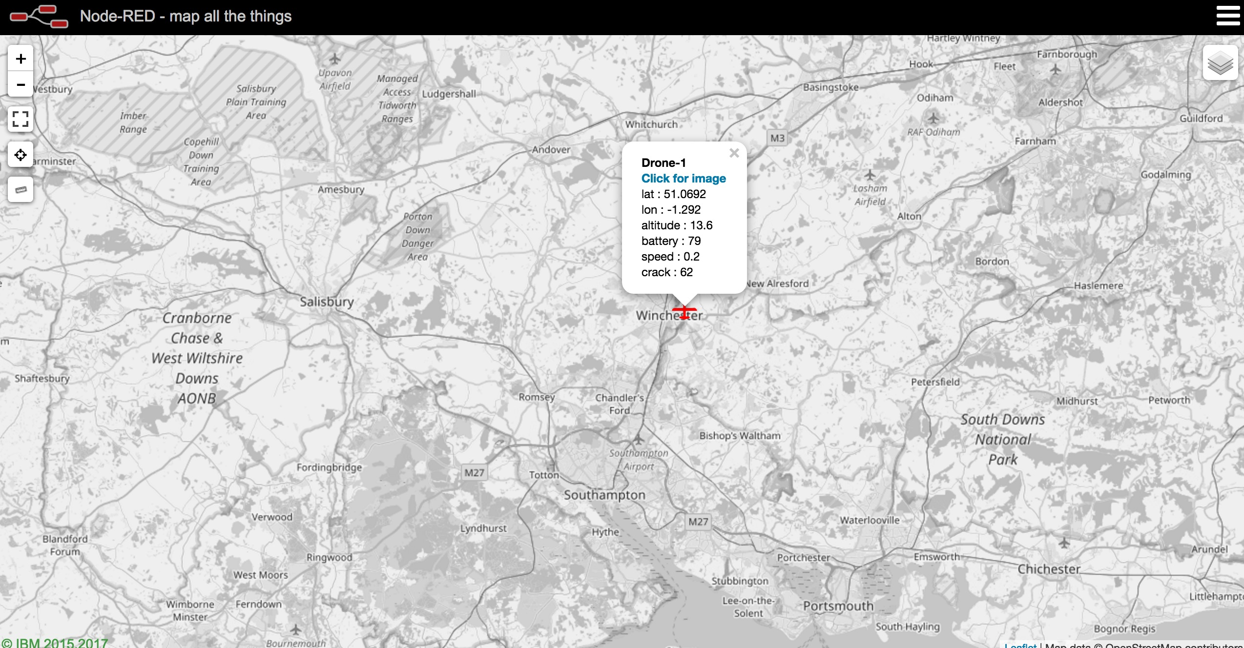
Objective

Slide 4
Agenda
setup Visual Recognition and Object Storage instances in IBM Cloud
train a custom classifier
create Object Storage and upload test images
import and customise Node-RED flow
add a web URL input capability to your dashboard
extend application to use Node-RED mapping service

Slide 5

What is the VR service?
The Watson Visual Recognition service uses deep learning algorithms to analyse images for scenes, objects, faces, and other content
Built-in classes provide highly accurate results without training
can train custom classifiers and collections using your own images

Slide 6
VR Use Cases
The Visual Recognition service can be used for diverse applications and industries…
Manufacturing: Use images from a manufacturing setting to make sure products are being positioned correctly on an assembly line
Insurance: Rapidly process claims by using images to classify claims into different categories
Social commerce: Use an image of a plated dish to find out which restaurant serves it and find reviews, use a travel photo to find vacation suggestions based on similar experiences, use a house image to find similar homes that are for sale
Retail: Take a photo of a favorite outfit to find stores with those clothes in stock or on sale, use a travel image to find retail suggestions in that area
Education: Create image-based applications to educate about taxonomies, use pictures to find educational material on similar subjects
Visual Auditing: Look for visual compliance or deterioration in a fleet of trucks, planes, or windmills out in the field, train custom classifiers to understand what defects look like
Notes:
- Assembly line - product positioning and fault finding
- Insurance claims - recording accidents, severity, etc.
- Retail - similarity search for current fashion items
- Visual Auditing ... spot defects ...

Slide 7
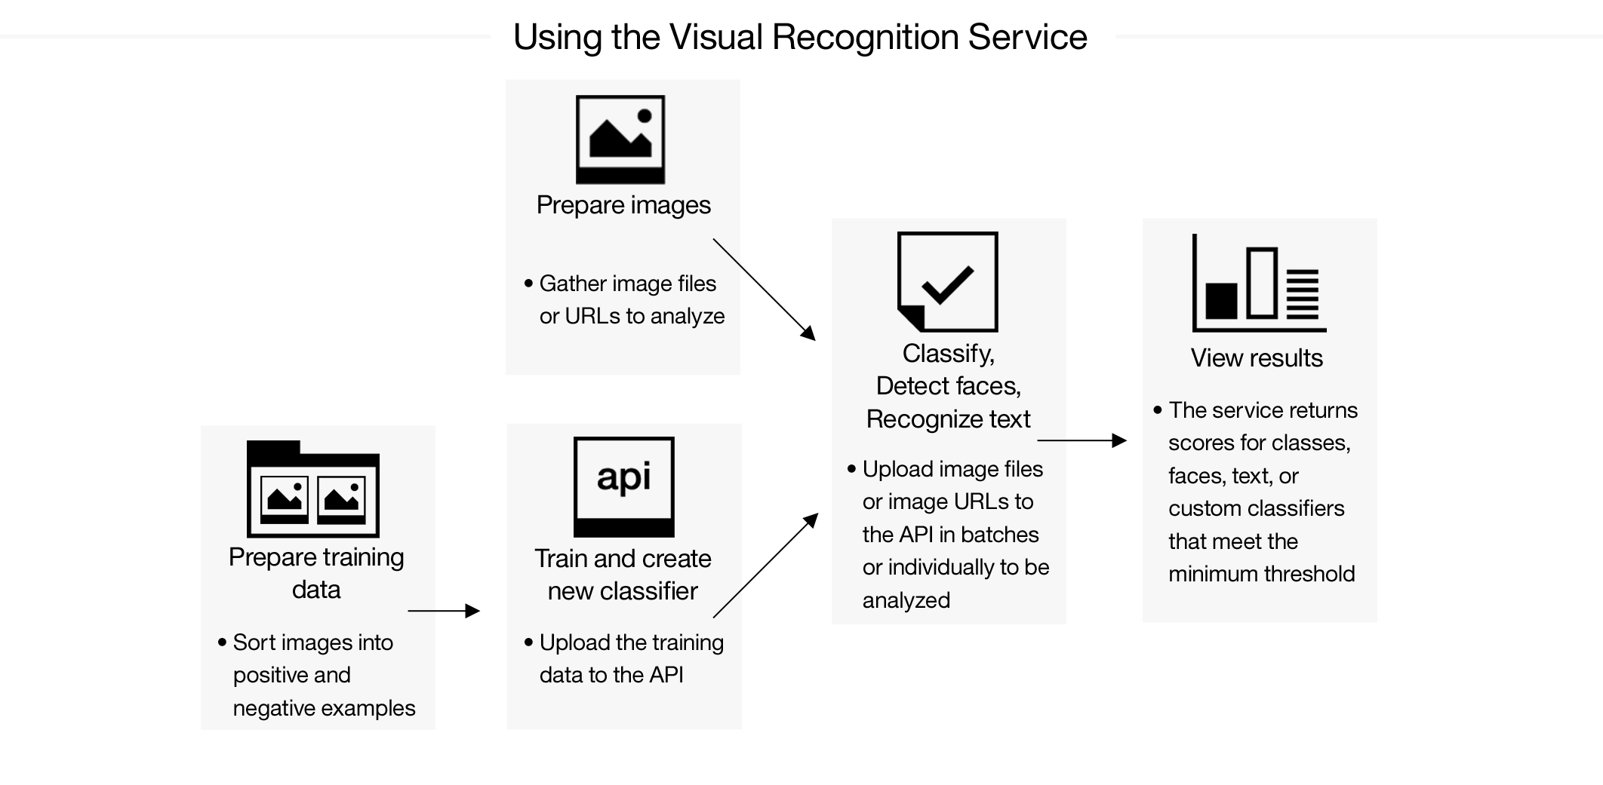
Using the VR service

Slide 8
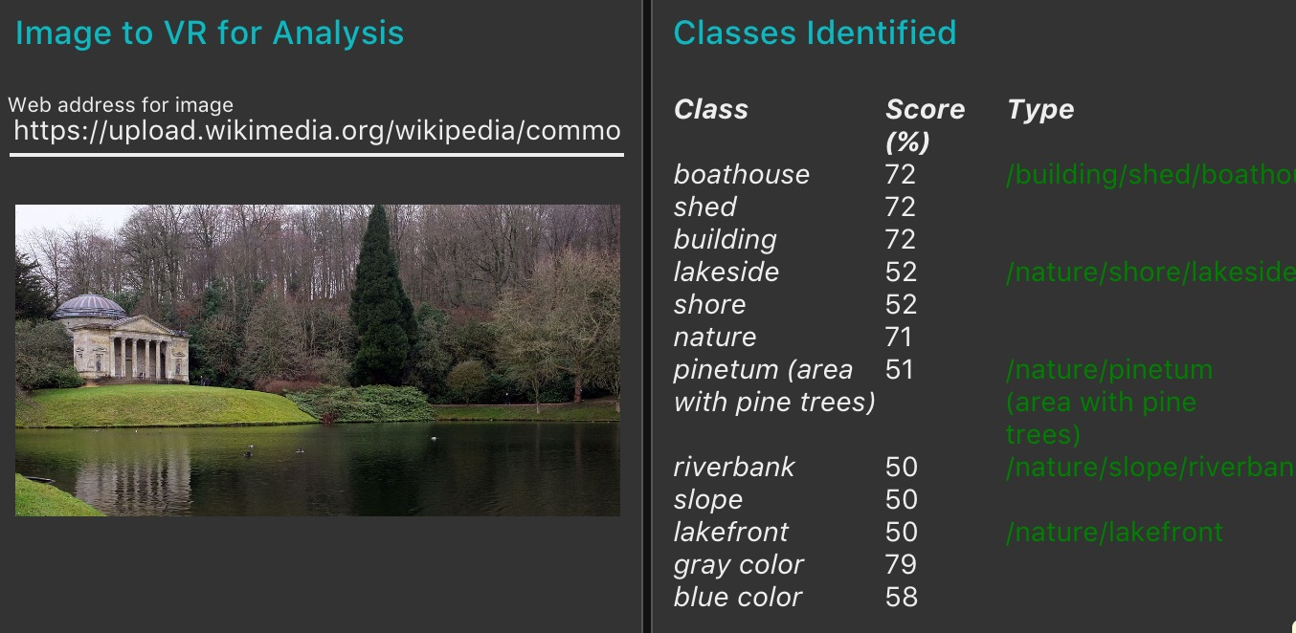
Image Classification
Default classifiers
Objects recognition
Trained to detect hundreds of classes – detects multiple classes
animals, person oriented information and activities, food, plants, sports, nature, transportation … and many more
OCR
Face detection
Multiple faces
Face position
Gender
Famous person
Age

Slide 9
Image Classification
Custom classifiers
Binary classifier
One class and negative examples
Distinction of two states – good / bad
Detection of one object – dog against cats
This lab uses a binary classifier
Multi-class classifier
Distinguishes between multiple types of objects
The Extras lab uses a multi-class classifier

Slide 10
Image Classification
Modification of created classifiers
Classes update, add new negative sample data
Add new classes
Limitations
Supported formats: JPEG, PNG
Maximum size for image scoring: 2 MB
Limitations of zip file: 100 MB, 10,000 images, min 10 images
Max 256 MB zip file per training call
Recommendations:
At least 50, but preferably 200–500 images per class/negative
Similar numbers of positive/negative images
Images should be at least 224x224 pixels (min 32x32)

Slide 11
Cognitive: Visual Recognition Gary Wilson Technical Leader & CTO, UKI Commercial Business

